Slide 1


DOMAINDAO.x State Your Name ✖ Stake Your Claim Powered by GhostFire Digital | AI Digital Underground™

Slide 2


Slide 3

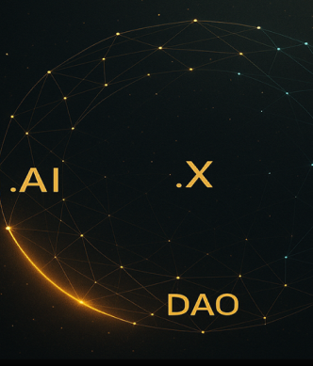
The Problem
✖ Domains stuck in Web1 — marketplaces are bland gatekeepers
✖ Generational inertia — early .com holders stagnate
✖ Speculation > Utility — culture & innovation ignored
✖ Missed opportunities — no DAO, no AI-native governance

Slide 4
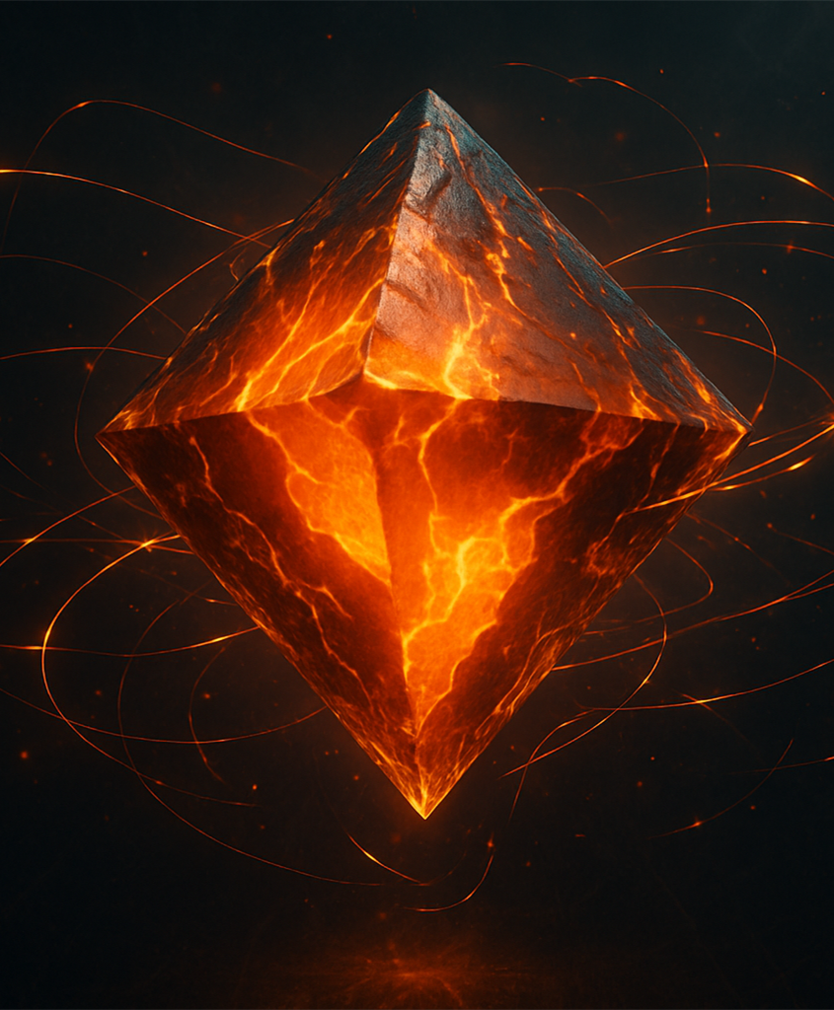
The Solution
DomainDAO.x = AI-enhanced, DAO-powered identity
ChainGPT-powered valuation + classification
Token-gated communities tied to domain NFTs
AI-generated governance proposals
Cross-chain portable identities

Slide 5
Market Opportunity
$610+ .AI domains (2025)
$30B+ DAO treasuries
$16T+ tokenized assets by 2030
$22B+ domain market
$400B+ AI industry (2027)
→ No DAO uniting domain industry yet: massive whitespace

Slide 6
Architecture
Protocol Layer: Smart contracts for NFTs
1
AI Layer: ChainGPT Agents for valuation + proposals
2
Community Layer: Token-gated access + voting
3
Application Layer: Dashboard with AI insights & governance portal
4

Slide 7
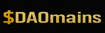

Tokenomics
Earn rewards for curation & participation
Governance rights — propose & vote
Stake for gated access + perks

Slide 8

Phase 1: (0–3m): MVP testnet, ChainGPT valuation, gated chat Phase 2: (3-6m): AI proposals, DAO voting, dispute resolution Phase 3: (6–12m): $DAOmains token launch, cross-chain bundles
Roadmap

Slide 9

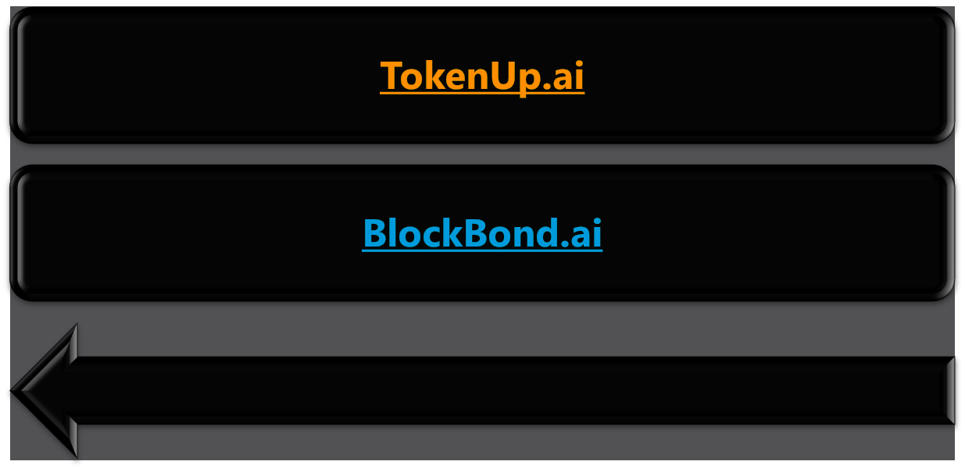

Impact & Use Cases

Slide 10

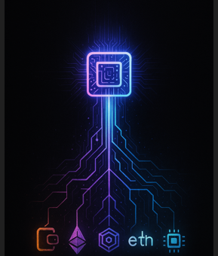
The Ask
Frontend MVP + governance tools
Token-gated pilot launch
Seeking $50K via ChainGPT Builders Program
ChainGPT API integration

Slide 11

Founder & Studio
Founder: Scott Backman (aka Grimy.40oz)
Studio: GhostFire Digital | AI Digital Underground™
Slogan: State Your Name ✖ Stake Your Claim
Website: https://DomainDAO.x
Whitepaper: https://github.com/GhostFireX/DomainDAO.x/blob/main/DomainDAOx_Whitepaper_BlackEdition.pdf
https://github.com/GhostFireX/DomainDAO.x/blob/main/DomainDAOx_Whitepaper_Grant.pdf
Pitch Deck: https://ghostfire.ai/downloads/PitchDeck_DomainDAO.x_Grant.pptx
Contact: scott@ghostfire.ai | +1 719-464-4084

